Slide 1

Spatial Machine Learning
Applications and Case Studies in Spatial Machine Learning
Dr. Giri Rajasekhar Gunnu
Professor of Practice, Andhra University
📧 g.giri.iitm@gmail.com
🔗 LinkedIn: girigunnu

Slide 2
Environmental Monitoring and Management
1
From Reactive Measurement to Proactive Prediction
Key: Hyper-local AQ nowcasting; wildfire ignition susceptibility

Slide 3
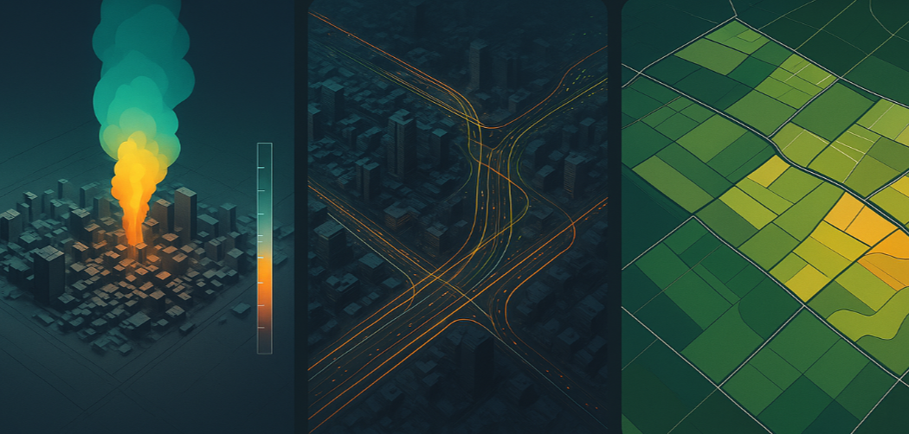
Our Case Study Domains
Environmental Monitoring & Management: Public health and ecosystem resilience.
Urban & Regional Planning: Sustainable, safe urban environments.
Agriculture & Resource Manaement: Precision analytics for food and resources.

Slide 4
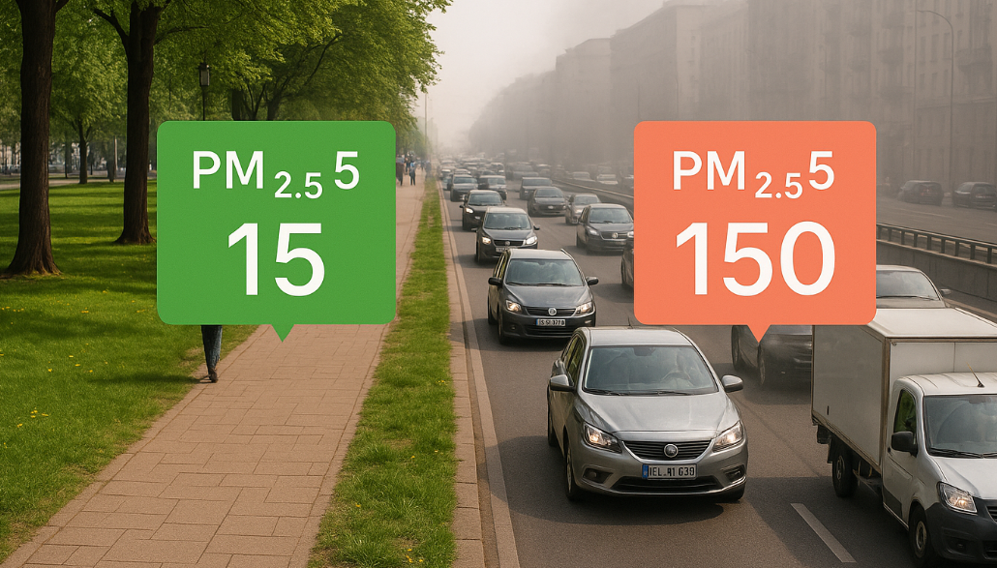
Case Study 1: Hyper-Local Air Quality Nowcasting
Problem: City averages hide neighborhood spikes from traffic/weather/industry.
Objective: 100m-resolution 6-hour nowcast for actionable alerts & management.

Slide 5
Air Quality: The Multi-Modal Data Fusion Challenge
Data Source | Role in Model | Key Limitation
Ground Sensors | Ground Truth (Training Target) | Spatially Sparse, Point Data
Sentinel-5P Satellite | Spatial Context (Aerosol Index) | Low Temporal Resolution (Daily)
ERA5 Weather Model | Dynamic Drivers (Wind, Pressure) | Coarse Spatial Resolution (~25km)
Road Network (OSM) | Static Proxies for Emissions | Indirect relation to real-time traffic

Slide 6
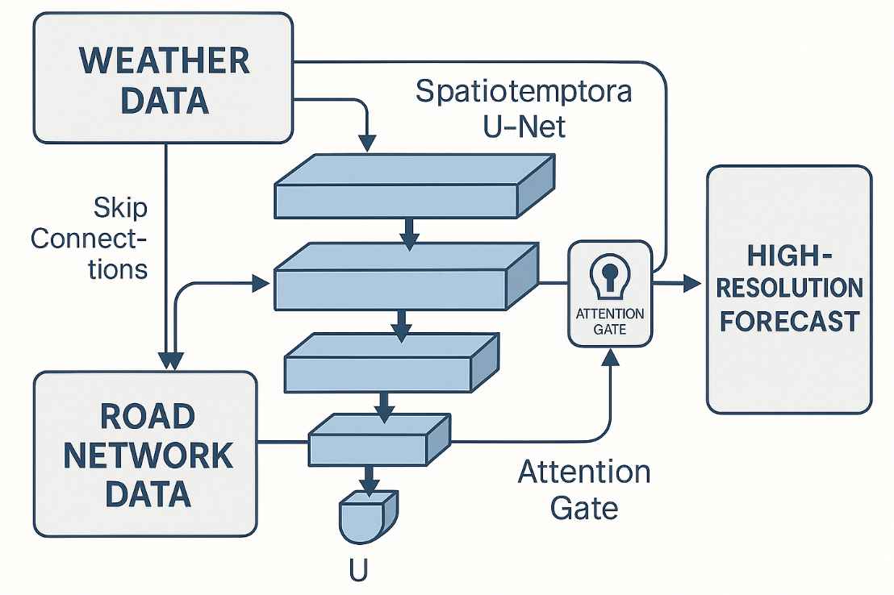
Air Quality: Architectural Rationale
Decompose: Learn temporal evolution (weather) and spatial downscaling (roads + aerosol).
Rejected: ConvLSTM on weather only misses hyper-local traffic effects.
Model: Spatiotemporal U-Net + Attention (skip connections inject high-res road features; attention focuses upwind sources).

Slide 7
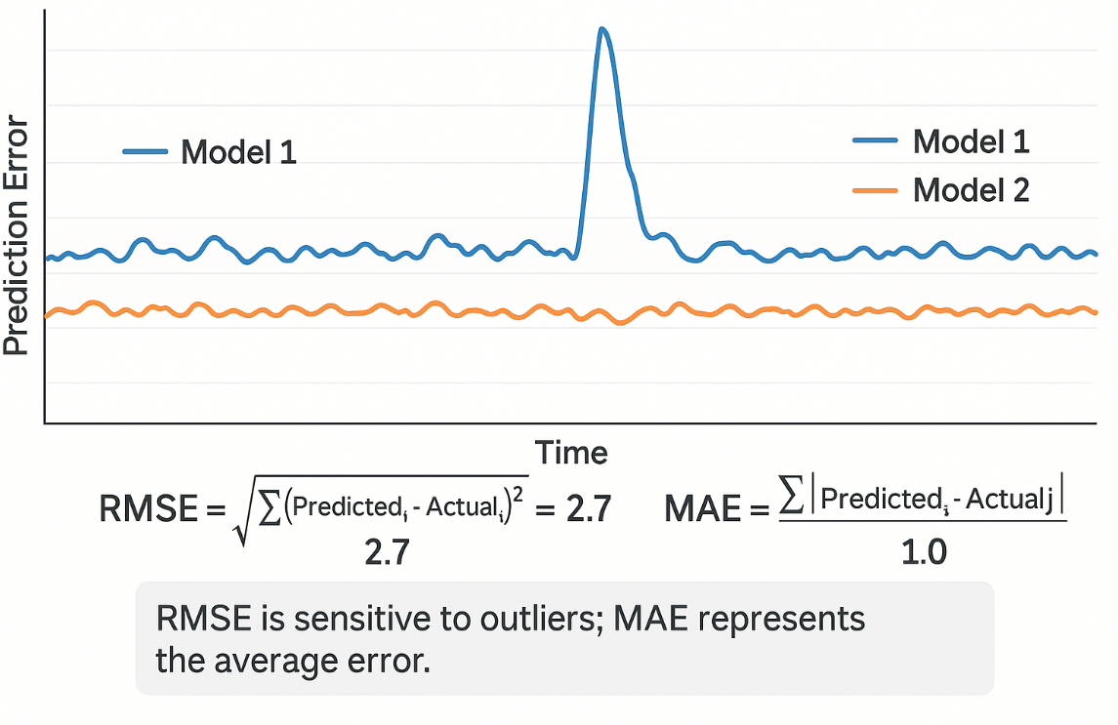
Evaluation Deep Dive: Why MAE over RMSE?
RMSE penalizes outliers heavily; MAE is stable & interpretable for officials.
MAE = average absolute error; robust to extreme events (e.g., industrial fire).
Result: MAE ≈ 4.8 µg/m³ on 6-hour forecast.

Slide 8
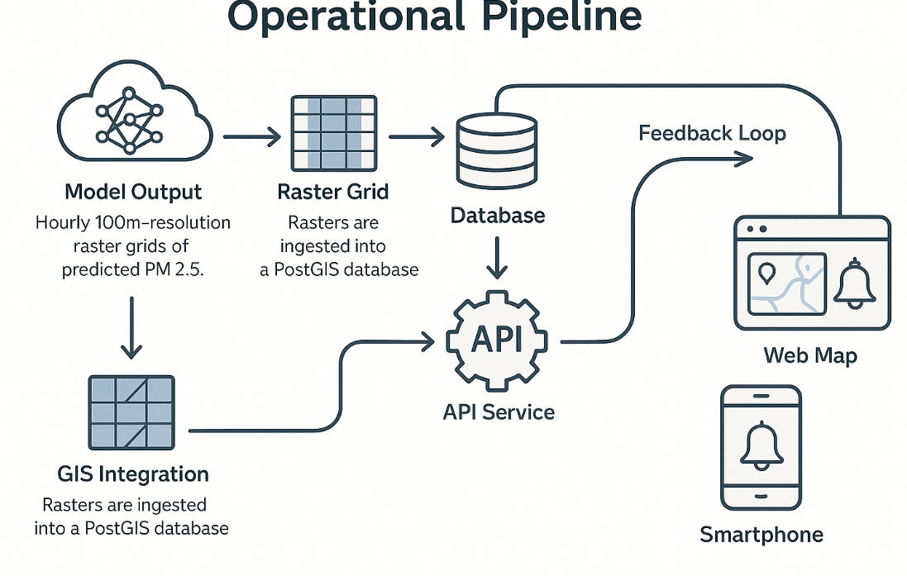
From Prediction to Actionable Intelligence (AQ)
Output: Hourly 100m PM2.5 rasters.
GIS: PostGIS ingest; API exposes queries by location/time.
Apps: Web map + smartphone alerts.
MLOps: Quarterly retraining with new sensor data for seasonality.

Slide 9
Case Study 2: Wildfire Ignition Susceptibility Modeling
Problem Statement: Prevention is cheaper than suppression. Instead of just mapping general "risk," we need to model the daily, weather-driven probability of a new fire igniting at any given location.
Societal Objective: Create a dynamic, daily 30m-resolution susceptibility map to guide pre-positioning of firefighting resources and issue public warnings on high-risk days.

Slide 10
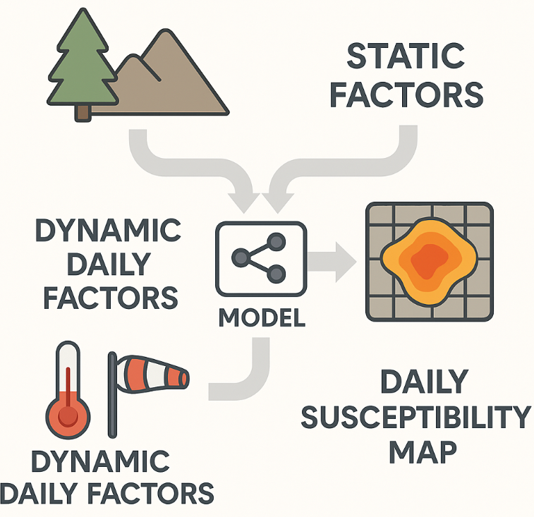
Wildfire Susceptibility: The Geo-Informatics Data Stack
Static: Fuel (land cover), slope/aspect, proximity to roads.
Dynamic: Temp, humidity, wind, days since rain (GRIDMET).
Target: Daily ignitions (VIIRS/MODIS).
Data Type | Factors / Variables | Data Source(s)
Static | Fuel / Land Cover, Slope, Aspect, Proximity to Roads | LANDFIRE, SRTM DEM, OpenStreetMap
Dynamic | Temperature, Relative Humidity, Wind Speed, Days Since Last Rain | GRIDMET Weather Dataset
Target | Daily Fire Ignitions (0/1) | VIIRS / MODIS Active Fire Satellites

Slide 11
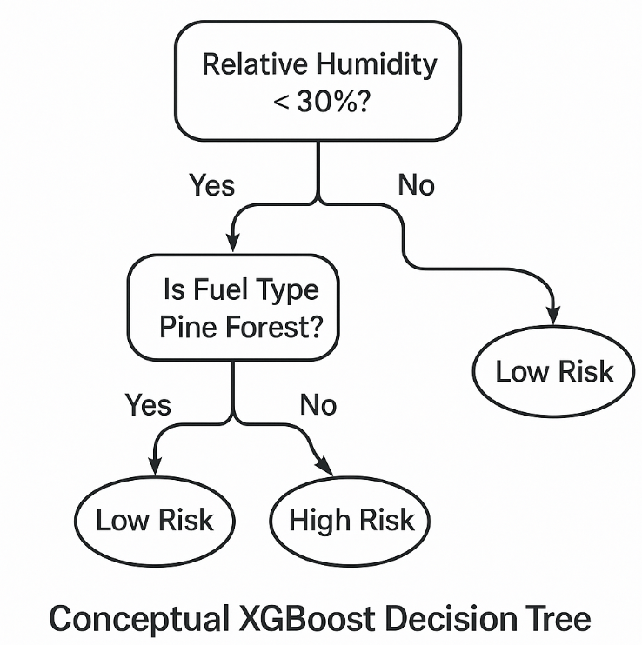
Wildfire Susceptibility: Architectural Rationale (XGBoost)
Challenge: Non-linear interactions + severe class imbalance.
Model: XGBoost with scale_pos_weight for rare positive class.
Captures interactions (e.g., dry pine + south-facing + high wind).

Slide 12
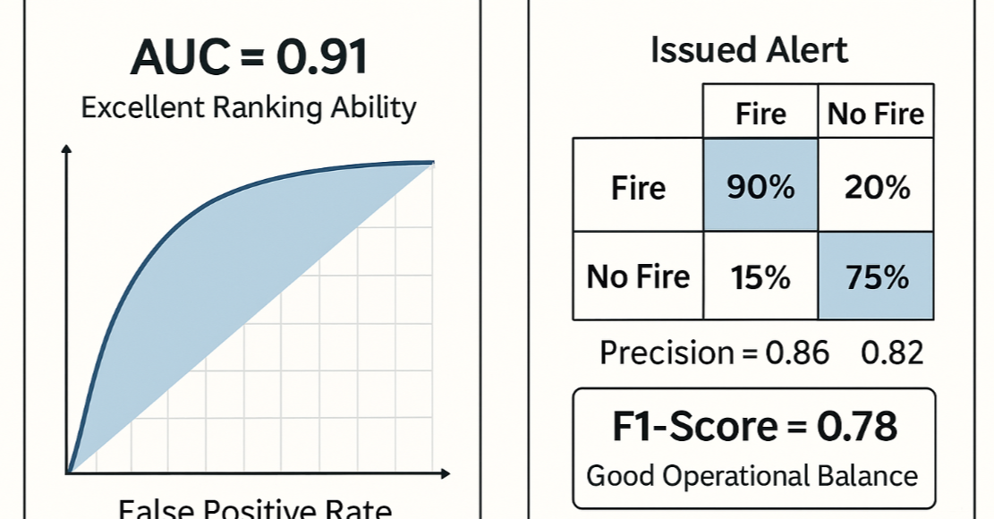
Evaluation Deep Dive: Why AUC and F1-Score?
Accuracy fails under rarity; AUC tests ranking ability.
Operational thresholding → F1 balances precision/recall.
Results: AUC ≈ 0.91; F1 ≈ 0.78.

Slide 13
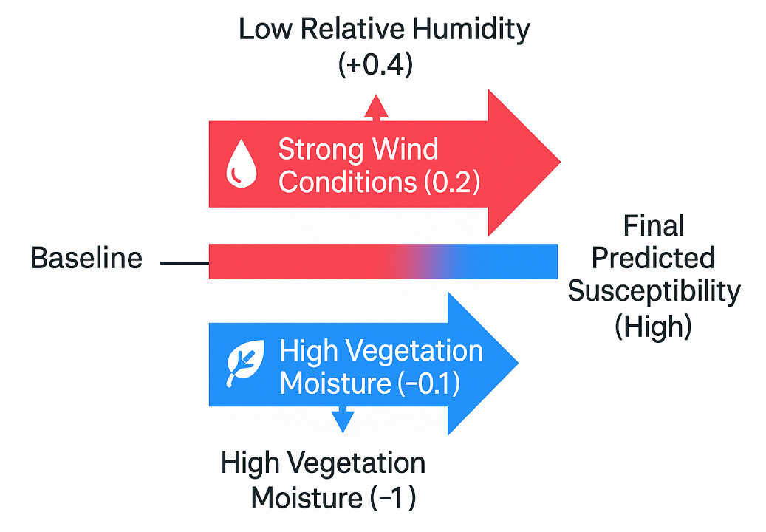
Wildfire Susceptibility: Model Explainability with SHAP
Trust via SHAP(SHapley Additive exPlanations): feature attributions per prediction.
Example: Low humidity (+0.4), high winds (+0.2), near road (+0.1).

Slide 14
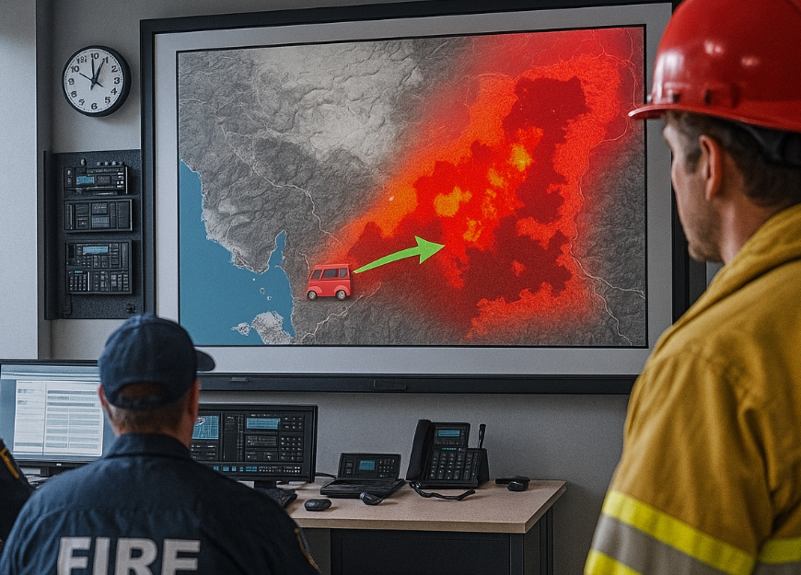
Wildfire Susceptibility: From Model to Mission
The Product: A dynamic, daily-updating web map accessible to fire management agencies.
Actionable Intelligence:
Strategic (Pre-positioning): On a high-risk day, a fire engine and crew are moved from a low-risk area to a station bordering a predicted high-susceptibility zone.
Tactical (Patrols): Air patrols are routed over the areas with the highest predicted susceptibility for rapid detection of new ignitions.

Slide 15
AQ: Data Engineering & QC
Temporal alignment across sources
Spatial joins & resampling
Gap-filling & masking
Normalization/standardization

Slide 16
AQ: Baselines, Ablations & Uncertainty
Persistence & climatology baselines
Ablations: remove satellite/roads/weather
Monte Carlo dropout for uncertainty

Slide 17
AQ: Bias & Fairness
Sensor placement bias
Neighborhood exposure equity
Communicating uncertainty to public

Slide 18
Wildfire: Monitoring & Drift
Seasonal shift detection
Model recalibration cadence
Field feedback integration

Slide 19
Mini-Case: NO₂ Hotspot Dynamics
Weekday/weekend signatures
Industrial vs traffic attribution
Policy what-if scenarios

Slide 20
Mini-Case: Smoke Plume Advection
Wind-driven dispersion
Hybrid physical–ML coupling
Event-based evaluation

Slide 21
Section 1 Discussion Prompts
Which data gaps most limit accuracy?
How to operationalize uncertainty?
Next automation targets?

Slide 22
Urban and Regional Planning
2
Building Data-Driven, Resilient, and Sustainable Cities
Automated LULC; near-real-time damage assessment

Slide 23
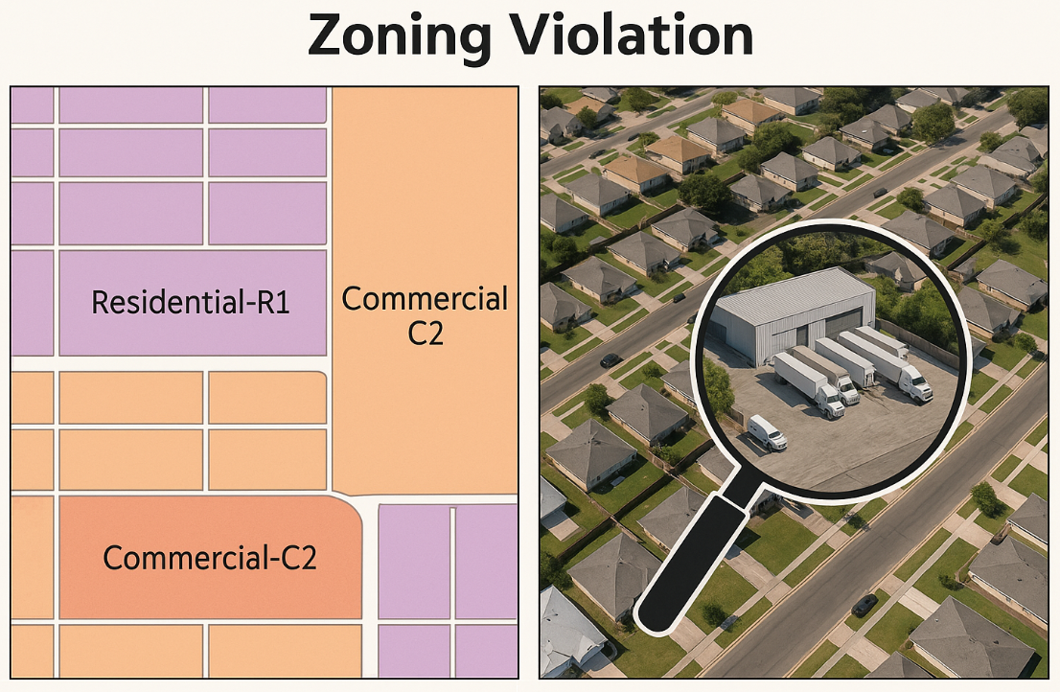
Case Study 3: Automated LULC Mapping for Zoning Compliance
Problem Statement: Urban zoning plans are legal documents, but verifying compliance over a large city is a slow, manual, and expensive process. How can we use AI to automate the creation of a high-fidelity LULC map to flag potential zoning violations?
Societal Objective: Ensure fair and consistent enforcement of zoning laws, accelerate planning cycles, and create a dynamic baseline for understanding urban development patterns.

Slide 24

LULC: The Geo-Informatics Data Stack & The Labeling Bottleneck
Concept: The performance of any deep learning model is capped by the quality and quantity of its training data. For segmentation, this is a major challenge.
Data:
Input Imagery: 0.3m resolution, 4-band (R,G,B, NIR) aerial imagery.
Training Data (The Bottleneck): A manually digitized, pixel-perfect segmentation mask for several representative areas of the city. Creating this is extremely labor-intensive.
Classes: Single-Family Residential, Multi-Family Residential, Commercial, Industrial, Park/Greenspace, Impervious Surface (Roads/Parking).

Slide 25
LULC: Data Stack & The Labeling Bottleneck
Item | Details
Input Imagery | 0.3m, 4-band (RGB+NIR) aerial imagery
Training Data (Bottleneck) | Pixel-perfect masks for representative areas (labor-intensive)
Classes | SFR, MFR, Commercial, Industrial, Park/Greenspace, Impervious (Roads/Parking)

Slide 26
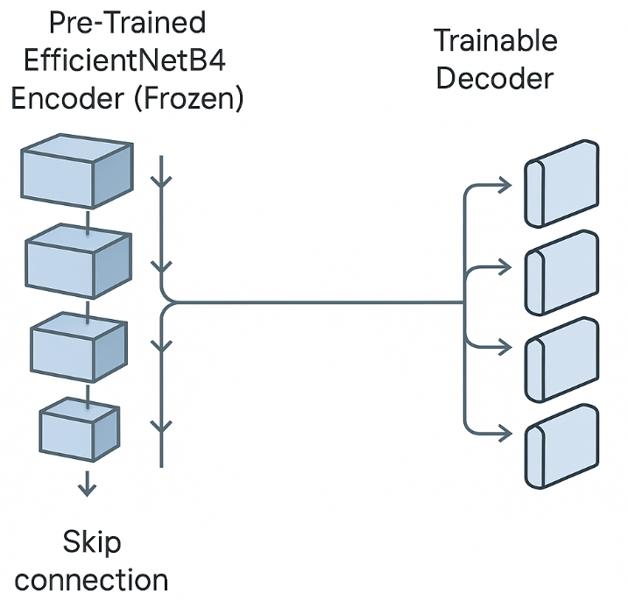
LULC: Architectural Rationale
Problem Decomposition: We need a model that produces a dense, pixel-level prediction. It must understand both local texture (e.g., the texture of a shingled roof) and global context (e.g., a collection of houses and yards forms a residential neighborhood).
Rejected Alternative: A simple CNN for classification of image tiles is insufficient because it doesn't produce a clean boundary for each feature.
Model Choice: A U-Net architecture with a pre-trained EfficientNetB4 encoder.
Why:
U-Net: The standard for semantic segmentation, its skip connections are crucial for preserving fine-grained spatial detail.
Transfer Learning (EfficientNetB4): Instead of a random encoder, we use one pre-trained on ImageNet. This allows the model to leverage a powerful, pre-existing understanding of visual features, dramatically reducing the amount of labeled data we need to create.

Slide 27
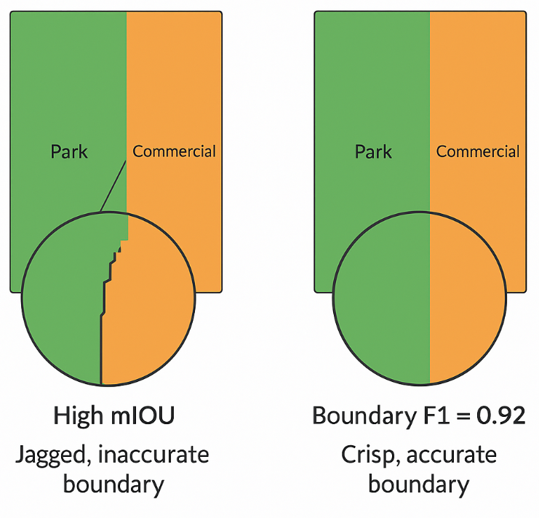
Evaluation Deep Dive: Boundary Metrics Matter
The Flaw of Pixel Accuracy: If 90% of a city is residential, a model that predicts "residential" everywhere has 90% accuracy but fails to map any other class.
Mean Intersection over Union (mIoU): The standard metric for segmentation quality. It measures the overlap between predicted and true regions for each class.
Boundary F1 (BF1) Score: A more advanced metric that specifically measures the alignment of the boundaries between classes. In zoning, the precise location of the boundary between a commercial and residential lot is often the most critical factor.
Realistic Results: mIoU = 0.85, Boundary F1 = 0.79.

Slide 28
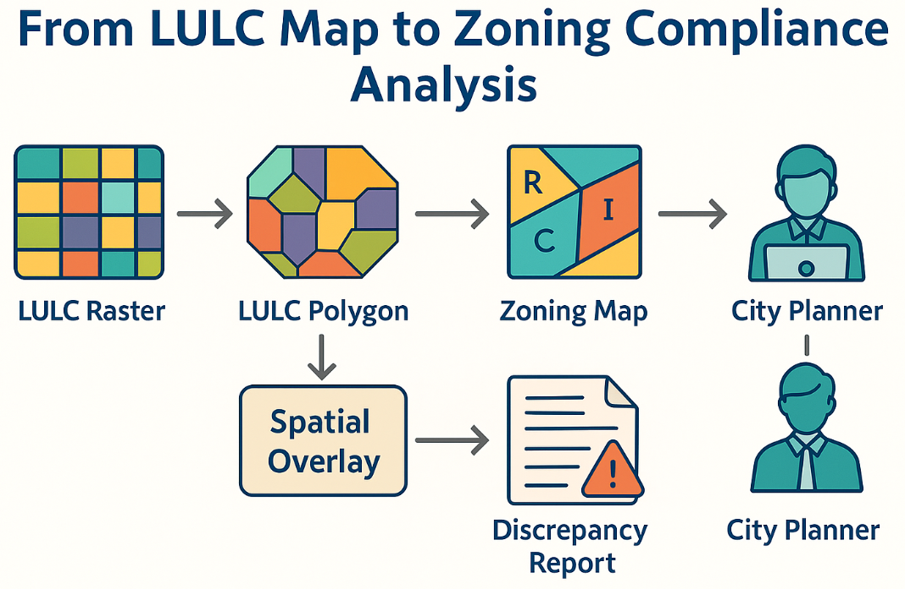
From LULC Map to Zoning Compliance Analysis
The Operational Pipeline:
Model Output: A high-resolution LULC raster map.
GIS Vectorization: The raster is converted into polygons for each land use class.
Spatial Overlay Analysis: The model-derived LULC polygons are overlaid with the official zoning parcel map in a GIS.
Automated Flagging: A script identifies discrepancies (e.g., a parcel zoned 'Residential' that contains a polygon classified as 'Industrial').
Human Verification: The flagged parcels are presented to a city planner in a review dashboard to verify the potential violation.

Slide 29
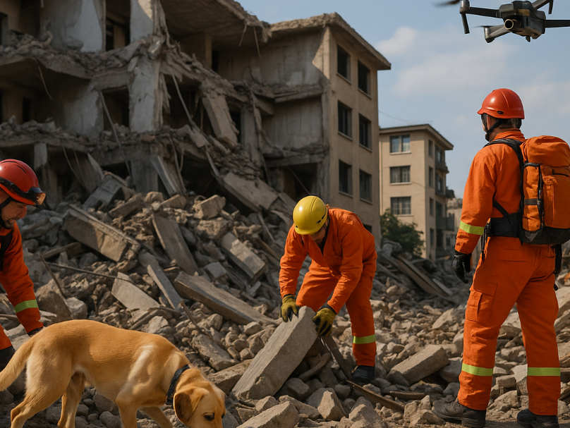
Case Study 4: Near-Real-Time Post-Earthquake Damage Assessment
Problem Statement: In the chaotic hours after a major earthquake, emergency responders need to know which buildings have collapsed or are severely damaged to prioritize search and rescue.
Societal Objective: Develop a deep learning pipeline that can ingest post-event satellite/drone imagery and produce a building-level damage assessment map within 2-4 hours of image acquisition.

Slide 30
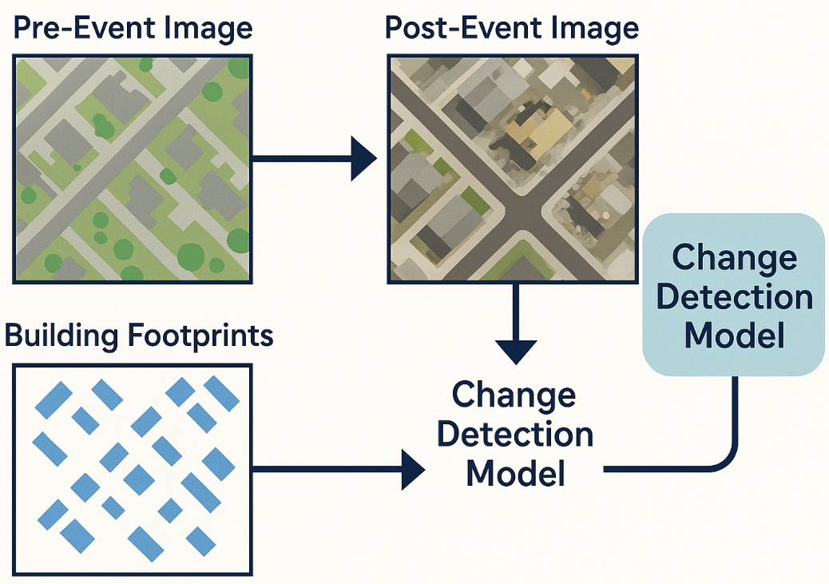
Damage Assessment: Data Fusion & Temporal Challenge
Concept: This is a change detection problem. The model's primary task is to learn what constitutes "significant change" indicative of damage.
Data:
Pre-Event Satellite Image (Baseline): 0.5m resolution optical imagery.
Post-Event Satellite/Drone Image (Target): Imagery captured post-event.
Building Footprints (OSM/Microsoft): A vector layer of building locations.
Training Data (xBD Dataset): A large public dataset containing labeled pre/post image pairs and damage levels from numerous global disasters.

Slide 31
Damage Assessment: Architectural Rationale
Problem Decomposition: The model must effectively compare two images, identify subtle differences that indicate damage (e.g., rubble piles, missing roofs), and localize these changes to specific building footprints.
Model Choice: A Siamese U-Net with a dual-attention mechanism.
Why:
Siamese Encoders: The twin towers are the ideal architecture for comparing two images. They learn to extract comparable feature representations from both pre- and post-event imagery.
U-Net Decoder: The decoder structure allows the model to produce a pixel-level map of damage.
Attention Mechanism: Attention gates help the model focus on the most salient changes, learning to ignore irrelevant differences like shadows, different lighting conditions, or cars that have moved.

Slide 32
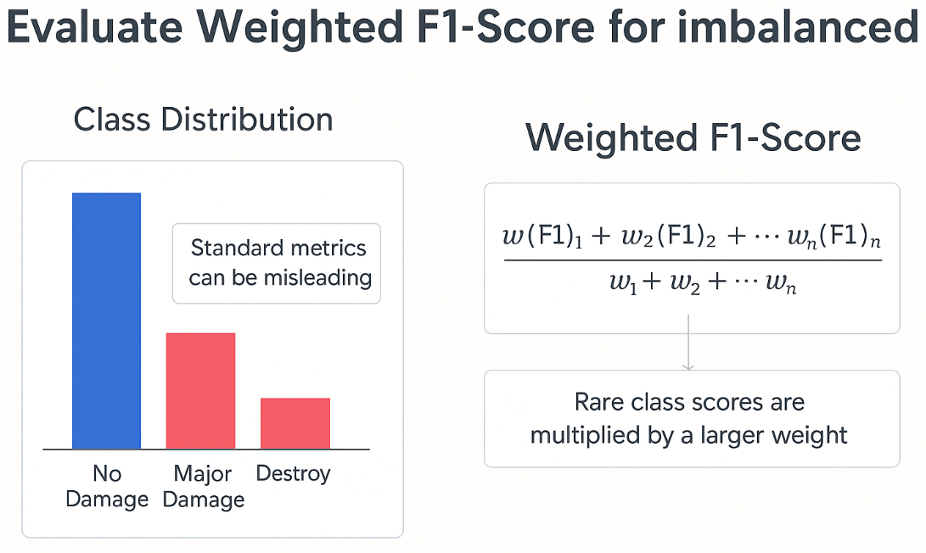
Evaluation Deep Dive: Weighted F1 for Imbalanced Classes
The Imbalance Problem: In most disasters, the vast majority of buildings are undamaged. The Destroyed and Major Damage classes are rare.
The Flaw of Standard F1: A standard F1-score might look high because the model is excellent at correctly identifying the common No Damage class, but it could be failing on the rare, critical classes.
Solution: Weighted F1-Score. This metric calculates the F1-score for each class independently and then computes a weighted average, giving more importance to the scores of the rare classes. This provides a better assessment of the model's performance on the classes we care about most.
Realistic Results: Weighted F1-Score = 0.82.

Slide 33
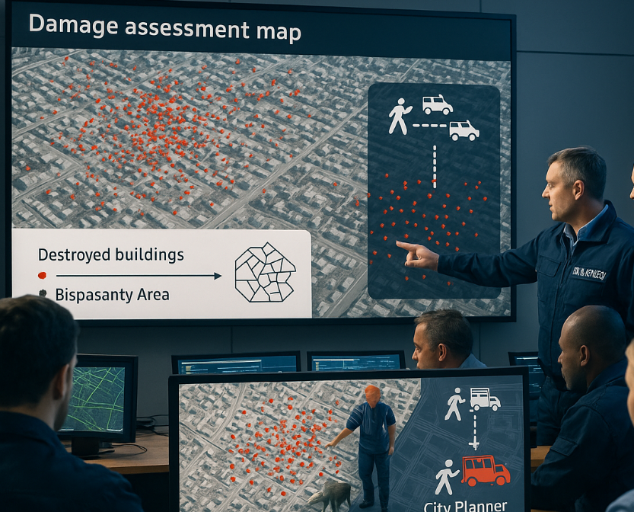
From Damage Map to Coordinated Response
The Operational Pipeline:
Rapid Processing: Post-event imagery is ingested into a cloud-based GPU pipeline.
Model Inference: The Siamese U-Net runs, producing a building-level damage classification raster.
GIS Analysis: The raster is joined with building footprint vectors.
Dashboarding: The results are immediately pushed to a web-based dashboard (e.g., ArcGIS Dashboards) and a mobile app for field teams (e.g., Survey123).
Actionable Intelligence: Field teams are directed to the areas with the highest concentration of "Destroyed" buildings, bypassing areas of no damage and dramatically increasing the efficiency of search and rescue operations.

Slide 34
Case Study 4b: Traffic Forecasting with ST-GNNs
Problem: Predict corridor speeds/flows
Impact: Signal timing, routing, safety, emissions

Slide 35
Traffic Data Stack
Graph: sensors/intersections (nodes); road segments (edges)
Temporal: 5–15 min speeds/flows
Exogenous: weather/events/incidents

Slide 36
ST-GNN Architecture
Graph conv for spatial deps
Temporal module (GRU/LSTM/Attention)
Multi-horizon outputs

Slide 37
Training & Metrics
Sliding windows & rolling validation
MAE/RMSE/MAPE vs baselines
Incident robustness tests

Slide 38
Deployment
Streaming inference
Integration with city control centers
APIs for navigation apps

Slide 39
Equity & Governance
Sensor placement bias
Fairness in routing
Transparent comms

Slide 40
Interoperability
OGC, STAC, GeoParquet
City data platform APIs
Privacy-preserving sharing

Slide 41
Urban Summary
Automated LULC
Rapid damage assessment
ST-GNN traffic operations

Slide 42
Agriculture & Resource Management
3
Deploying Data-Driven Systems for a Sustainable Future
In-season nitrogen management; continental soil moisture

Slide 43
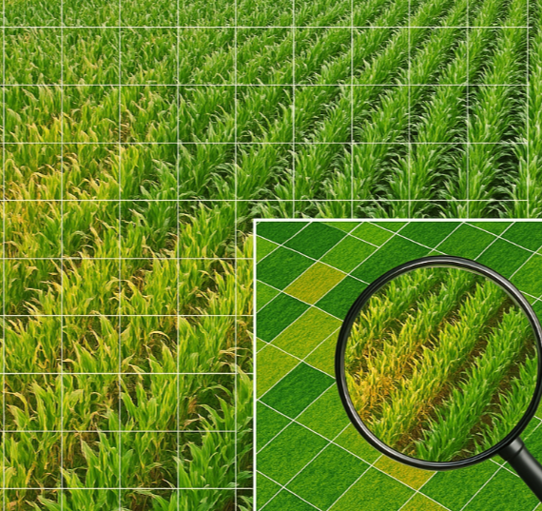
Case Study 5: In-Season Crop Nitrogen Recommendation
Problem Statement: Uniformly applying nitrogen fertilizer is economically wasteful and environmentally harmful (e.g., water pollution). Yield is limited by the most nitrogen-deficient zones.
Economic Objective: Develop a system that generates a Variable Rate Application (VRA) map, telling farmers the precise amount of nitrogen (in kg/hectare ) to apply to every 10m x 10m section of their field to maximize profit, not just yield.

Slide 44
Crop Nitrogen: The Geo-Informatics Data Stack
Data Layer | Role in Model | Engineering Challenge
Drone Multispectral (NDRE) | In-season health proxy | Cost/ha, data volume, atmospherics
Soil Properties (EC) | Nutrient-holding capacity | One-time scan expense
Topography (RTK-GPS) | Water flow & nutrient pooling | High-precision DEM generation
Experimental Strips | Ground truth (rates vs yield) | Season-long on-farm experiments

Slide 45
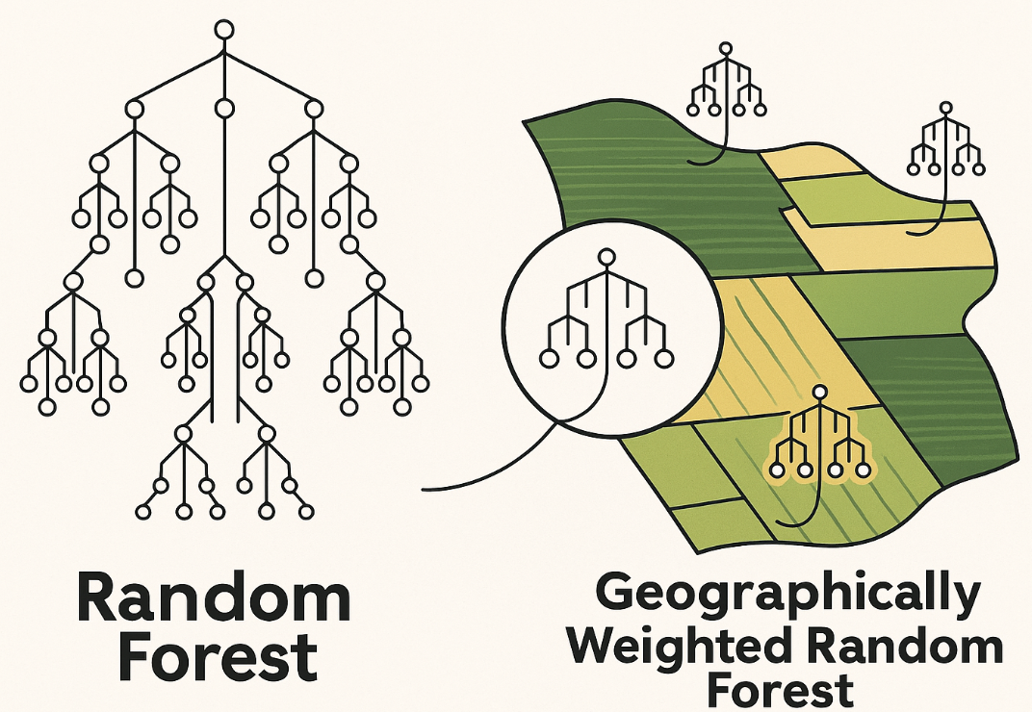
Crop Nitrogen: Architectural Rationale
Problem Decomposition: The model must learn a complex, non-linear function: Optimal_N_Rate = f(NDRE_t, Soil_EC, Slope).
Rejected Alternative: A simple linear regression would fail to capture the known non-linear response of crops to nitrogen.
Model Choice: A Geographically Weighted Random Forest (GWRF).
Why:
Random Forest: It's excellent at modeling the complex, non-linear interactions in the tabular data.
Geographically Weighted (GWR aspect): It accounts for spatial non-stationarity. The optimal nitrogen rate for a given NDRE value might be different in a low-lying clay soil area versus a sandy hilltop area within the same field. The GWRF trains a local Random Forest for each location, weighting nearby training strips more heavily.

Slide 46
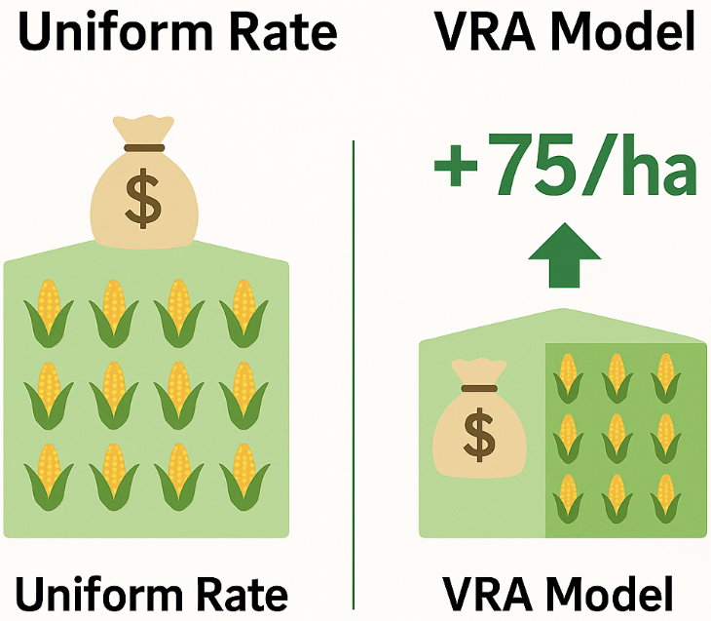
Evaluation Deep Dive: Profit Maximization, not just RMSE
The Flaw of RMSE: Minimizing the error in predicting yield (RMSE) is not the same as maximizing the farmer's profit. The cost of fertilizer is a key variable.
The Real-World Metric: Net Return ($/hectare).
Calculation: For each test plot, we calculate: Profit = (Predicted_Yield * Price_of_Corn) - (Applied_N_Rate * Cost_of_Nitrogen).
Evaluation: We compare the average profit from our model's VRA prescription map against the profit from the farmer's standard uniform application rate.
Realistic Result: A successful model might show a +$50-75/hectare increase in net return.

Slide 47
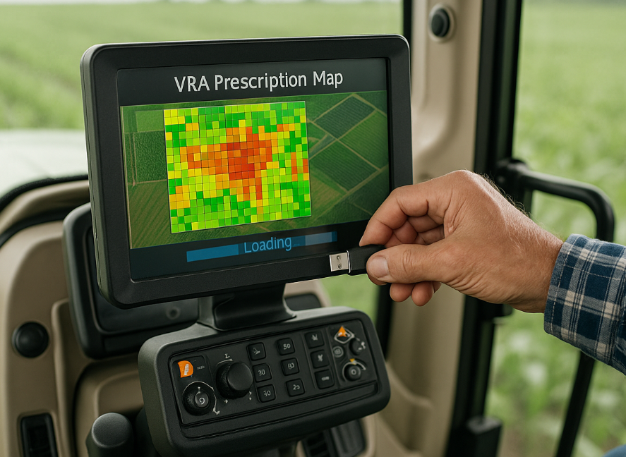
From Model to Machine: The Deployment Pipeline
The Operational Product: A VRA prescription map in a standardized format (e.g., ISOXML or Shapefile).
The Pipeline:
Farmer uploads drone imagery and soil data to a cloud platform.
The GWRF model runs, generating the prescription map.
The farmer downloads the map to a USB drive.
The drive is plugged into the tractor's cab controller.
The tractor's GPS and rate controller automatically execute the map, adjusting the fertilizer nozzles in real-time as it drives across the field.

Slide 48

Case Study 6: Continental-Scale Soil Moisture Mapping
Problem Statement: Soil moisture is a critical variable for drought monitoring, flood prediction, and agricultural planning, but ground sensors are sparse.
Societal Objective: Create a daily, 1km-resolution map of surface soil moisture for an entire continent (e.g., Africa) to power a drought early warning system.

Slide 49
Soil Moisture: The Geo-Informatics Data Stack
Data Source | Role in Model | Key Limitation
Sentinel-1 SAR | High-res texture proxy | Narrow swath; vegetation interference
SMAP | Direct but coarse measurement | Very low spatial resolution
ERA5 Land | Physics-based estimate | Inaccuracy in complex terrain
In-situ Sensors | Validation ground truth | Extremely sparse distribution

Slide 50
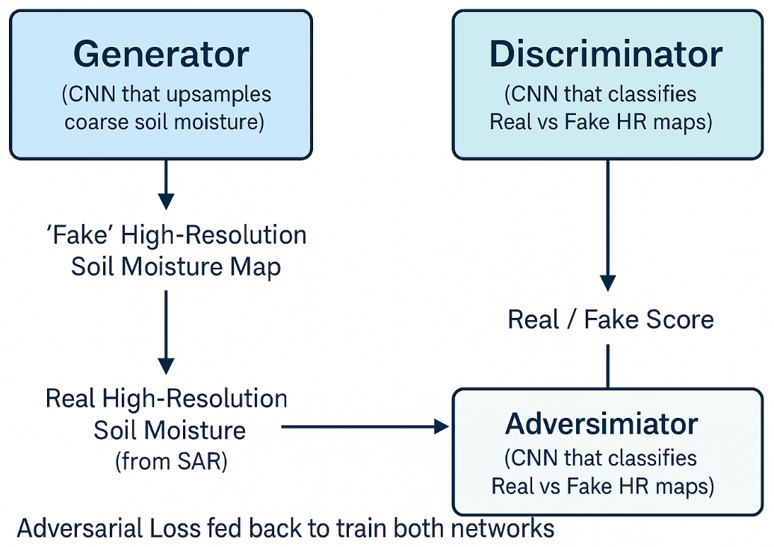
Soil Moisture: Architectural Rationale (GAN/SRGAN)
Problem Decomposition: This is a classic downscaling problem. We need to learn a function that can translate coarse-resolution SMAP/ERA5 data into high-resolution soil moisture maps, using the high-resolution texture and structure from Sentinel-1 SAR as a guide.
Model Choice: A Generative Adversarial Network (GAN), specifically a super-resolution GAN (SRGAN).
Why:
The Generator: A CNN trained to produce a realistic-looking, high-resolution soil moisture map from a coarse-resolution input.
The Discriminator: A second CNN trained to distinguish between the Generator's "fake" high-res maps and "real" high-res maps (derived from complex processing of Sentinel-1).
Adversarial Training: The two models compete. The Generator gets better at making realistic maps, and the Discriminator gets better at spotting fakes. This competition pushes the Generator to produce extremely sharp, realistic results.

Slide 51
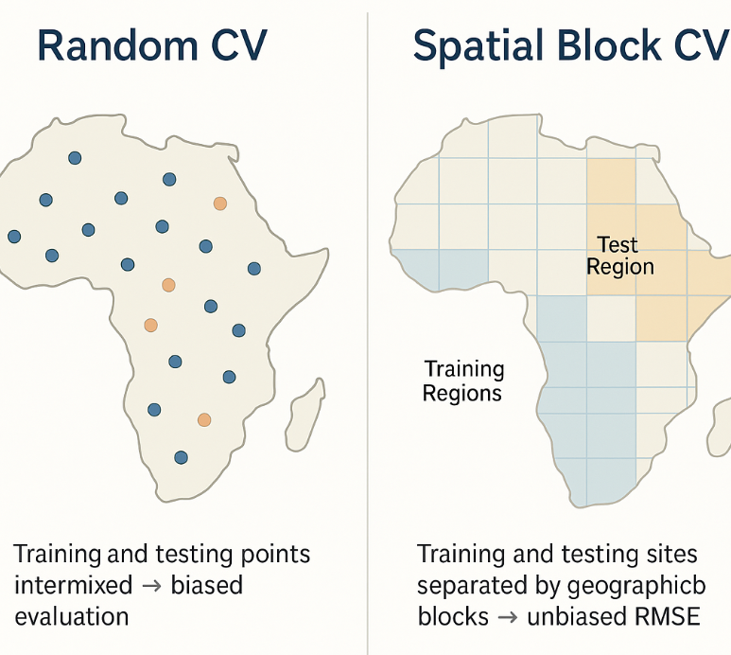
Evaluation Deep Dive: Unbiased RMSE with Spatial CV
The Metric: We use Root Mean Squared Error (RMSE) against the sparse in-situ sensor data to get an error in volumetric units (m³/m³).
The Challenge: Spatial Autocorrelation Bias. Ground sensors are often clustered. A standard random cross-validation would be biased, as the model would be tested on sensors that are very close to sensors it was trained on.
Solution: Spatial Block Cross-Validation. The continent is divided into large geographic blocks. The model is trained on data from some blocks and tested on data from completely separate blocks. This provides an honest, unbiased estimate of the model's performance in locations where it has no nearby ground truth.
Realistic Results: Unbiased RMSE = 0.04 m³/m³.

Slide 52
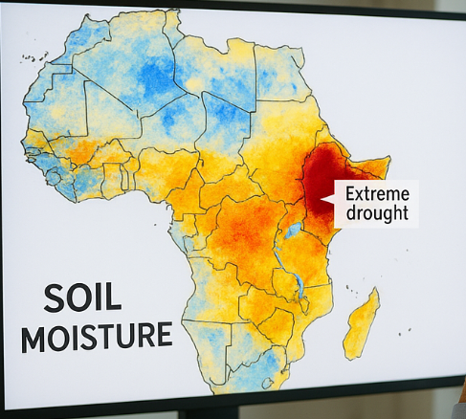
From Data Product to Early Warning System
The Operational Product: A daily, 1km raster map of soil moisture for the entire continent, delivered via a public data portal (e.g., an AWS Public Dataset).
Actionable Intelligence:
Drought Monitoring: Humanitarian agencies (e.g., WFP, USAID) use this data to identify regions entering agricultural drought weeks or months earlier than traditional methods.
Flood Forecasting: River basin authorities use the soil moisture map as a key input for hydrological models to predict flood risk after heavy rainfall. Saturated soils lead to rapid runoff.

Slide 53
Case Study 7: Climate Impacts on Yield (Summary)
Assess yield shifts under RCP/SSP scenarios
Bias-corrected climate ensembles
Adaptation strategies

Slide 54
Agri: Robustness & Generalization
Cross-season validation
Domain adaptation across regions
Uncertainty in recommendations

Slide 55
Agri: Sustainability Metrics
Runoff/nitrate reduction
Carbon outcomes
Regulatory compliance reporting

Slide 56
Agri: Farmer-Centered UX
Actionable thresholds
Mobile-first offline workflows
Explainability in maps

Slide 57
Agri Summary
GWRF prescriptions
GAN downscaling
From fields to continents

Slide 58
Chapter 5 Grand Summary
From theory to operations: rigorous workflow → actionable intelligence

Slide 59
The Geo-Informatics Engineer's Mandate
Be a Problem Solver: Start from the real question.
Be a Data Scientist: 80% is data sourcing/cleaning/fusion.
Be a Critical Thinker: Use XAI & robust validation to know limits.

Slide 60
The Future of Spatial Machine Learning
Foundation Models for Geo-AI (self-supervised EO pretraining).
Physics-Informed Neural Networks (PINNs).
AI at the Edge: on-board inference on drones/satellites.

Slide 61
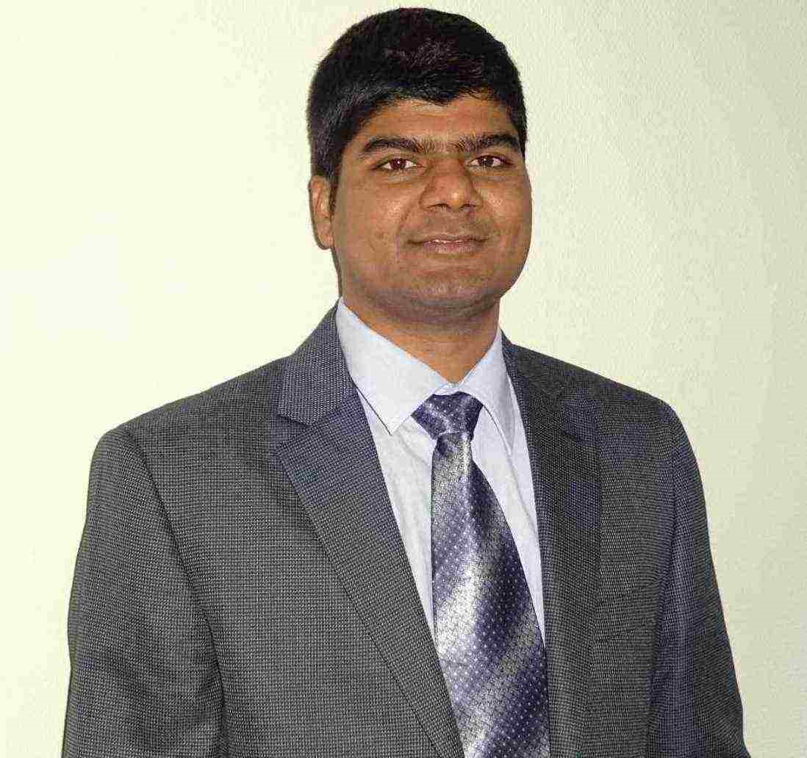
Myself
Dr. Giri Rajasekhar Gunnu
AI, Digital Twin & Industry Solutions Specialist | Industry 4.0 Specialist | Predictive Solutions Expert | Marine and Offshore Consultant
Professor of Practice, Andhra University
📧 g.giri.iitm@gmail.com
🔗 LinkedIn: girigunnu

Slide 62
Q&A
Welcome your questions and insights from all ranks
Your feedback helps us improve our CBPM implementation and ensures it meets the real-world needs of our fleet

